Slide 1
eLearning Progress report – Sprint c
17/06/23
58/Diogo Magalhães, Gabriel Silva,
Ricardo Peixoto, Ricardo Venâncio e Vicente Teixeira

Slide 2
agenda
Introduction
Completed Activities
System Objectives
Development Process
Critical Analysis of Results
Quality of the product
Sprint Retrospective
Self-Assessment

Slide 3
INTRODUCTION
This report provides an overview of our achievements, challenges, and a retrospective of what was done. We'll discuss key milestones reached, obstacles encountered, and future improvements. We will review our accomplishments and continue working together towards our shared goals.

Slide 4
Planning
The plan adopted by our team

Slide 5

Completed Activities
ID | Description | Assigned | Baseline | Real | Status
US3004 | As User, I want to share a board | Gabriel Silva | Start: 01-06-23 End: 07-06-23 | Start: 07-06-23 End: 15-06-23
US3005 | As User, I want to view, in real-time, the updates in the shared boards | Vicente Teixeira Ricardo Peixoto | Start: 25-05-23 End: 18-06-23 | Start: 05-06-23 End: 18-06-23
US3006 | As User, I want to create a post-it on a board | Ricardo Venâncio | Start: 01-06-23 End: 07-06-23 | Start: 25-05-23 End: 03-05-23
US3007 | As User, I want to change a post-it | Diogo Magalhães​ | Start: 29-05-23 End: 07-06-23 | Start: 09-06-23 End: 18-06-23
US3008 | As User, I want to undo the last change in a post-it | Gabriel Silva | Start: 29-05-23 End: 07-06-23 | Start: 05-05-23 End: 18-06-23

Slide 6
Completed Activities
ID | Description | Assigned | Baseline | Real | Status
US3009 | As User, I want to view the history of updates on a board | Vicente Teixeira Ricardo Peixoto | Start: 29-05-23 End: 07-06-23 | Start: 07-06-23 End: 18-06-23
US3010 | As User, I want to archive a board I own | Ricardo Venâncio | Start: 29-05-23 End: 18-06-23 | Start: 25-05-23 End: 05-06-23
US2004 | As Student, I want to take an exam | Ricardo Venâncio Ricardo Peixoto Vicente Teixeira Gabriel Silva Diogo Magalhães | Start: 01-06-23 End: 07-06-23 | Start: 01-06-23 End: 18-06-23
US2005 | As Student, I want to view a list of my grades | Gabriel Silva​ | Start: 29-05-23 End: 07-06-23 | Start: 09-06-23 End: 15-06-23
US2006 | As Teacher, I want to view a list of the grades of exams of my courses | Ricardo Peixoto | Start: 29-05-23 End: 07-06-23 | Start: 05-05-23 End: 18-06-23

Slide 7
Completed Activities
ID | Description | Assigned | Baseline | Real | Status
US2009 | As Student, I want to take an automatic formative exam | Ricardo Venâncio Ricardo Peixoto Vicente Teixeira Gabriel Silva Diogo Magalhães | Start: 01-06-23 End: 07-06-23 | Start: 07-06-23 End: 18-06-23
US4002 | As User, I want to cancel a meeting | Ricardo Venâncio | Start: 25-05-23 End: 31-05-23 | Start: 25-05-23 End: 31-05-23
US4003 | As User, I want to accept or reject a meeting request | Ricardo Venâncio | Start: 25-05-23 End: 31-05-23 | Start: 25-05-23 End: 03-05-23
US4004 | As User, I want to view a list of participants in my meeting and their status (accept or reject) | Ricardo Venâncio​ | Start: 25-05-23 End: 31-05-23 | Start: 25-05-23 End: 31-05-23
US5002 | The presentation itself | Ricardo Venâncio Ricardo Peixoto Vicente Teixeira Gabriel Silva Diogo Magalhães | Start: 29-05-23 End: 18-06-23 | Start: 16-06-23 End: 18-06-23

Slide 8
System objectives
The functional objectives and non-functional objectives

Slide 9
Functional objectives
Shared Boards
Exams
Users
Meetings
Courses

Slide 10
Non-Functional objectives
Java
GitHub
ANTLR
Persistence
Synchronization
Scripts
Documentation
Server

Slide 11
Development Process
What the team has adopted to achieve the results

Slide 12
Development process
Product quality is assured
Results satisfy the client needs with proper documentation
DISCOVERY
Collect ideas from team members
Early risks understood
PLANNING
Defining size, priority, and difficulty
Assigning tasks to team members
DESIGN
Development Planned
Product Design with respective documentation
Building our features based on the previous phase
Product quality needs to meet design requirement
LAUNCH
DEVELOPMENT

Slide 13
Critical analysis of results
Adopting the SWOT format

Slide 14
Critical analysis of results
High motivation and commitment to achieving team goals.
Positive team dynamics
Ineffective communication or conflicts within the team
Poor time management
Strengths
Weaknesses
Opportunities
Threats
Training and development of professional and soft skills
Implementation of new tools/technologies
Competition from other groups
Unforeseen events

Slide 15
Quality of the product
Results achieved by the team

Slide 16
Quality of the final product
Product Performance
Gathering Feedback
User Experience
Quality & Testing
Innovation
Product Maintenance

Slide 17
Sprint retrospective
Using the Starfish Method

Slide 18
Self-assessment
Evaluation made by the team about the skills before and after the project

Slide 19
Self-assessment
 | Before the project |  | After the project
 | Technical | Behavioral | Technical | Behavioral
Diogo Magalhães | Good | Good | Good | Good
Gabriel Silva | Good | Very Good | Very Good | Very Good
Ricardo Peixoto | Fair | Fair | Good | Good
Ricardo Venâncio | Good | Good | Good | Good
Vicente Teixeira | Good | Very Good | Very Good | Good
*scale consists of very weak, weak, fair, good, very good, excellent

Slide 20
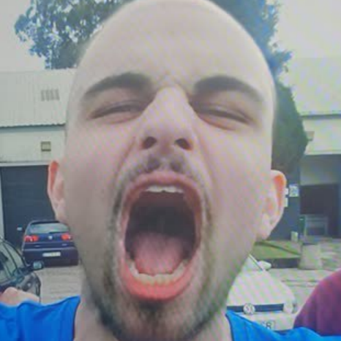
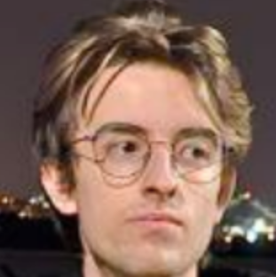
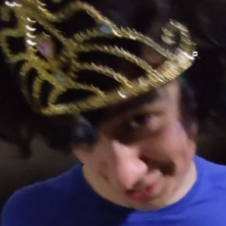
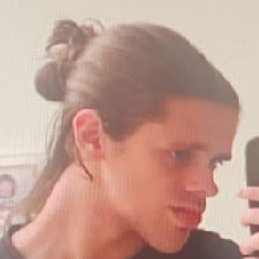
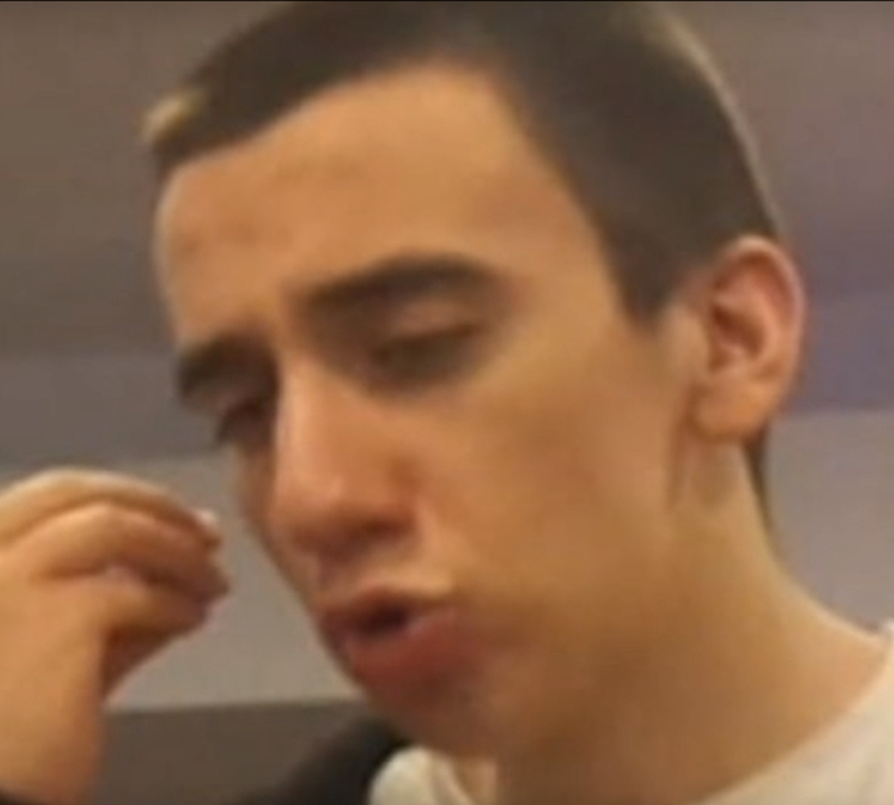
MEET OUR TEAM
Diogo Magalhães
Gabriel Silva
Ricardo Peixoto
Ricardo Venâncio
Vicente Teixeira

Slide 21
THANK YOU
The Group 58

